Slide 1

PRACTICAL
OBJECT-ORIENTED
DESIGN
WITH UML
2e
Chapter 3:
Software Development Processes

Slide 2
Software Development Processes
A methodology includes:
  a notation
  a process
UML has emerged as a standard notation for OOD
There is much less agreement about process

Slide 3
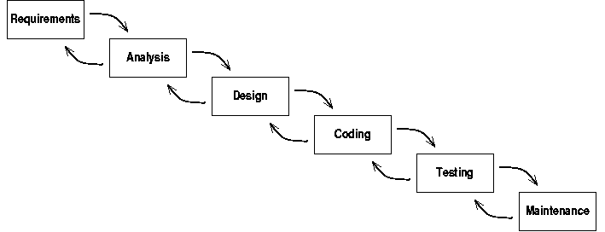
Waterfall Model
Development modelled as a series of stages

Slide 4
Waterfall Lifecycle
Each stage represents a different activity
Two ‘waterfall’ assumptions
  the stages take place in sequence
  each activity is completed before the next stage starts
Most versions allow some degree of feedback between stages

Slide 5
Risk and the Waterfall
Software development is unpredictable
Only testing can validate success of system
The waterfall model postpones testing until the end of the lifecycle
This creates high risk:
  we don't find out that the system is failing until the bulk of the development has been carried out

Slide 6
Requirements and the waterfall
Requirements always change
  complexity of many software systems
  systems fit into complex environments
  requirement change following installation
  flexibility of software makes change seem easy
Waterfall model fixes requirements at start
Inflexible: likely to fail if requirements change

Slide 7
Evolutionary Process Models
A response to the inflexibility of the waterfall model
Extensive use of executable prototypes
System evolves toward final form
  changes inspired by user feedback on prototypes
Weak for management purposes
  no development plan or project milestones

Slide 8
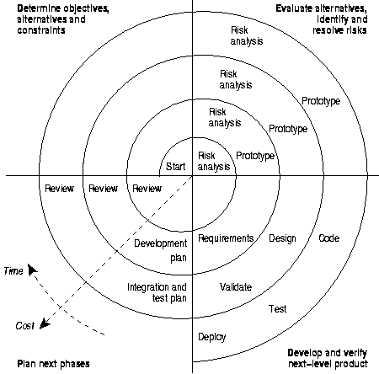
Spiral Model
An attempt to formalize the benefits of evolutionary styles without the management shortcomings

Slide 9
Characteristics of spiral model
Project iterates through development activities (repeated turns of the spiral)
4 quadrants represent major activities
Each iteration addresses the highest risk for the project
Model does not prescribe a fixed process
  detailed sequence of activities can differ depending on nature of project

Slide 10
Iterative and Incremental
Responses to waterfall model identify two characteristics of better process models:
  Incremental: don't plan to carry out all project in one go, but spread over a number of increments
  Iterative: various development activities get carried out repeatedly during development.
Current process models are all iterative and incremental

Slide 11
Unified Process (UP)
Current state-of-the-art methodology
Initially developed by designers of UML
Structures project as a number of phases
Each phase contains several iterations
Different workflows (activities) are performed in each iteration
  (notice the traditional set of activities)

Slide 12
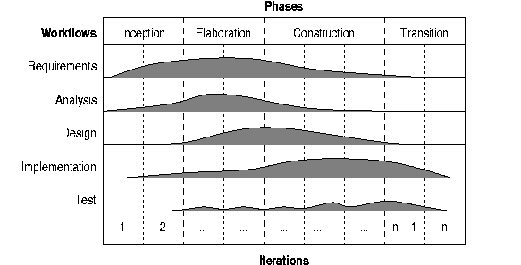
Unified Process Outline
The balance between workflows is different in different phases

Slide 13
UML and the Unified Process
UML is a language
It defines diagrams which represent aspects of software systems
UML’s diagrams can be used in conjunction with many different processes (or even in the absence of a formal process)
Because of their history, there is a close fit between UML and the UP

Slide 14
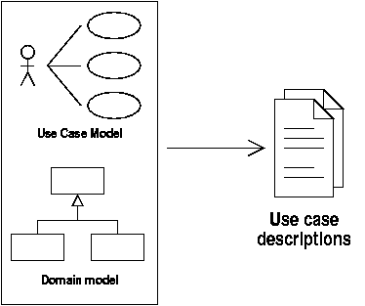
Requirements and Analysis
UP starts with use cases describing how users interact with the system
A domain model records facts about real world entities
UML use case and class diagrams document these

Slide 15
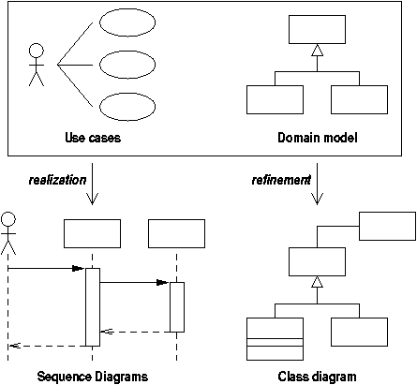
Realization and Refinement

Slide 16
Realization and refinement
Use case realizations indicate how the functionality will be supported by the system
Realizations are documented in UML interaction diagrams
This causes the domain model to be refined into a more implementation-oriented class diagram

Slide 17
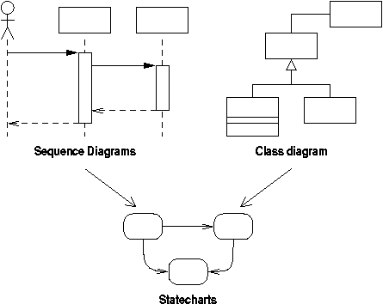
Specifying behaviour
Statecharts specify the behaviour of classes

Slide 18
Extreme Programming (XP)
XP is the modern inheritor of the evolutionary style of process model
Key practices:
  code review
  automated testing
  design refactoring (restructuring)
  continuous integration

Slide 19
Design Flexibility
XP stresses need to handle change
Recommends refactoring as development progresses
Assumes existence of technology that makes this feasible and cheap
Round-trip engineering: use of reverse engineering and code generation tools to keep design and code in step

Slide 20
Conclusions
Software development involves a number of typical activities:
  requirements specification
  analysis
  design
  implementation
  testing
It is usually not feasible to perform these in strict sequence

Slide 21
Current best practice
Use case driven
  process driven by user requirements
Management of risk
  iterative development phases
  incremental delivery of functionality
Flexibility
  refactoring
  round-trip engineering

